Slide 1
Introduction to Bioinformatics
Richard H. Scheuermann, Ph.D.
Director of Informatics
JCVI

Slide 2
Outline
What is Bioinformatics?
Some definitions
Data types and analysis objectives
Big Data
The Big Data value proposition
The Power of Bioinformatics
Extracting knowledge from data
DMID Systems Biology data in the Bioinformatics Resource Centers

Slide 3
What is Bioinformatics?
And related terms – biomedical informatics, computational biology, systems biology
Wikipedia
Bioinformatics: an interdisciplinary field that develops and improves on methods for storing, retrieving, organizing and analyzing biological data. A major activity in bioinformatics is to develop software tools to generate useful biological knowledge.
NIH Biomedical Information Science and Technology Initiative Consortium (BISTIC)
Bioinformatics: Research, development, or application of computational tools and approaches for expanding the use of biological, medical, behavioral or health data, including those to acquire, store, organize, archive, analyze, or visualize such data.
Computational Biology: The development and application of data-analytical and theoretical methods, mathematical modeling and computational simulation techniques to the study of biological, behavioral, and social systems.

Slide 4
What is Bioinformatics?
And related terms – biomedical informatics, computational biology, systems biology
Wikipedia
Bioinformatics: an interdisciplinary field that develops and improves on methods for storing, retrieving, organizing and analyzing biological data. A major activity in bioinformatics is to develop software tools to generate useful biological knowledge.
NIH Biomedical Information Science and Technology Initiative Consortium (BISTIC)
Bioinformatics: Research, development, or application of computational tools and approaches for expanding the use of biological, medical, behavioral or health data, including those to acquire, store, organize, archive, analyze, or visualize such data.
Computational Biology: The development and application of data-analytical and theoretical methods, mathematical modeling and computational simulation techniques to the study of biological, behavioral, and social systems.

Slide 5
Biological data types and analysis objectives
Genomics
Nucleotide genome sequences, metagenomic sequences
Gene finding, functional annotation, sequence alignment, homology determination, comparative analysis, phylogenetic inferencing, association analysis, mutation functional prediction, species distribution analysis
Transcriptomics
RNA expression levels, transcription factor binding, chromatin structure information
Differential expression, clustering, functional enrichment, transcriptional regulation/causal reasoning
Proteomics
Proteins levels, protein structures, protein interactions
Protein identification, protein functional predictions, structural predictions, structural comparison, molecular dynamic simulation, mutation functional prediction, docking predictions, network analysis
Metabolomics
Metabolite/small molecule levels
Pathway/network analysis
Imaging
Microscopy images, MRI images, CT scans
Feature extraction, high content screening
Cytometry
Cell levels, cell phenotypes
Cell population clustering, cell biomarker discovery
Systems biology
All of the above
Network analysis, causal reasoning, reverse causal reasoning, drug target prediction, regulatory network analysis, information flow, population dynamics, modeling and simulation

Slide 6

Big Data
BIG DATA

Slide 7
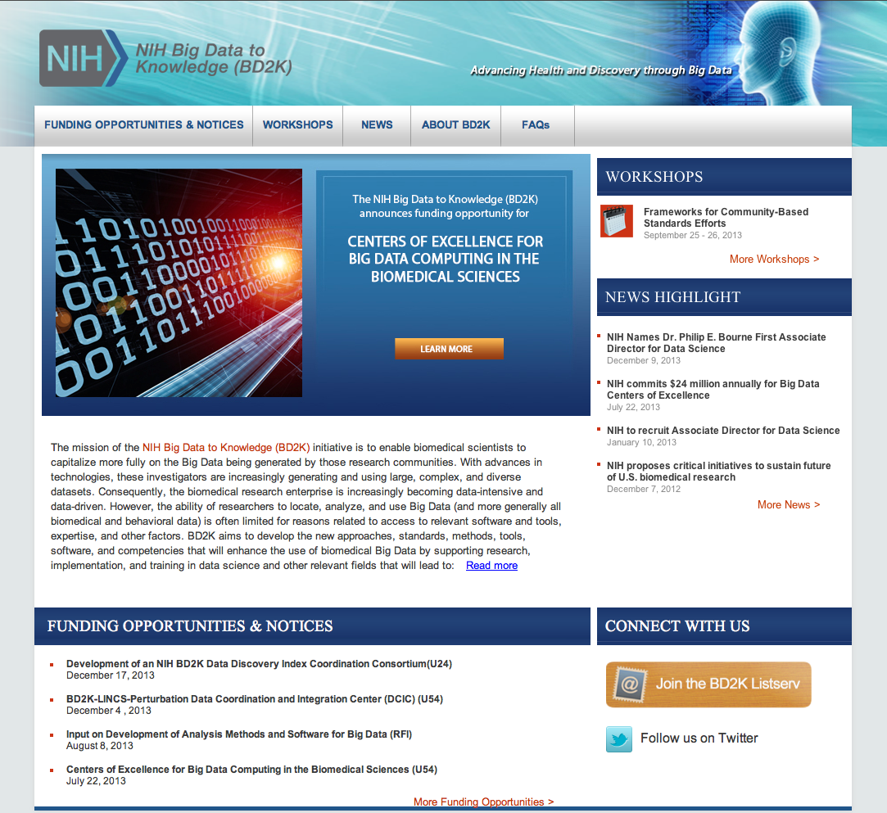
BD2K

Slide 8
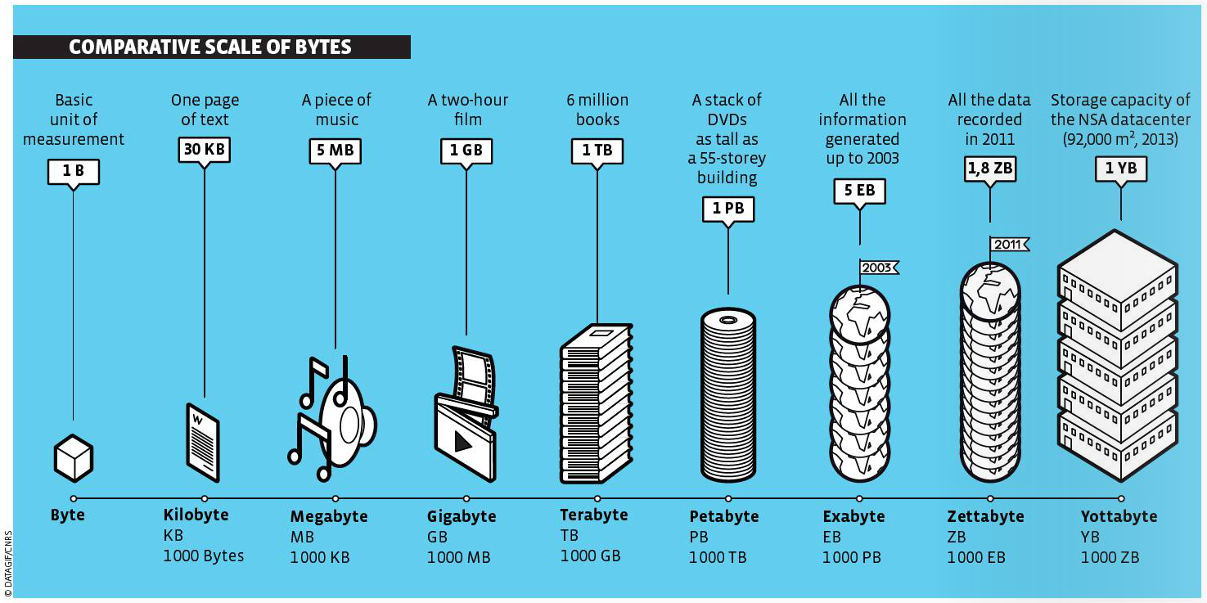
Big Data Volumes

Slide 9
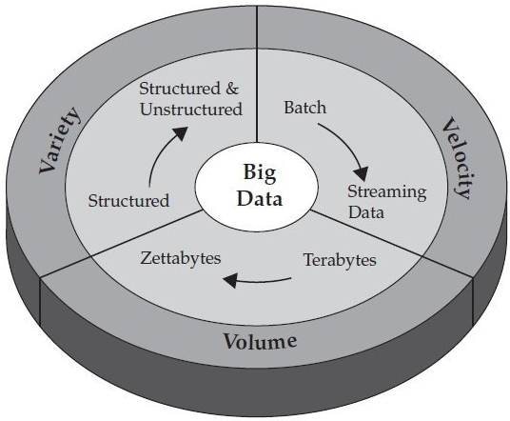
Big Data 3 V’s

Slide 10
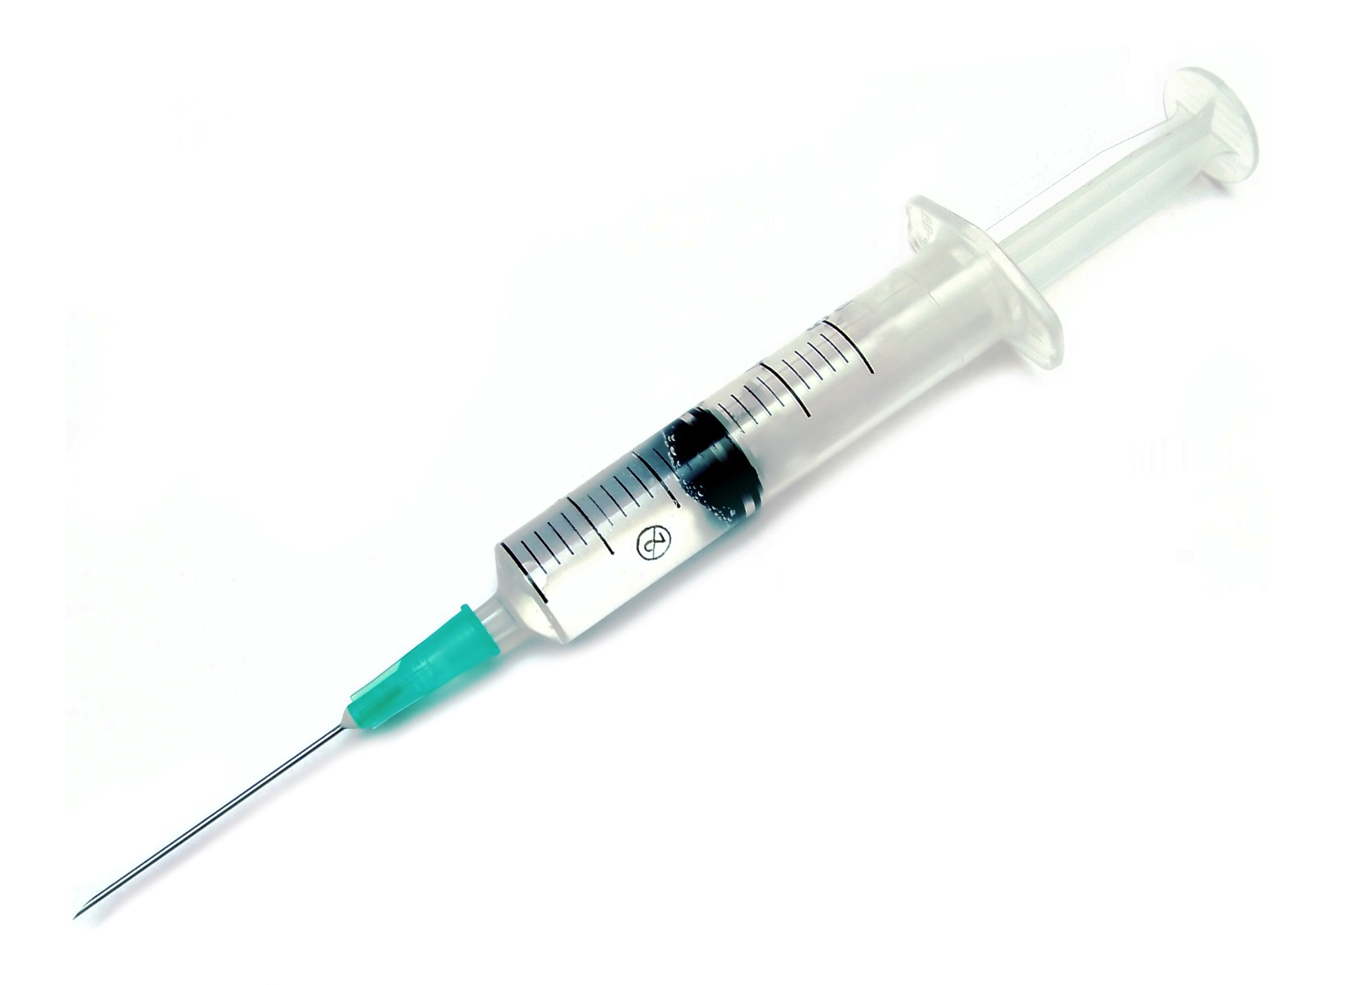
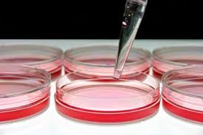
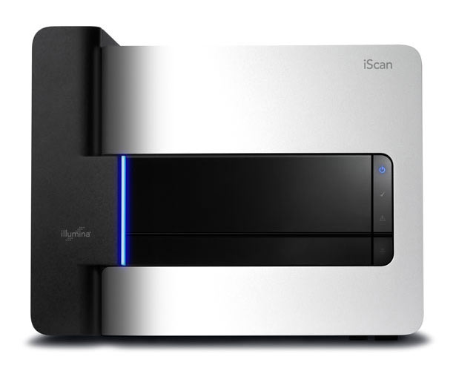
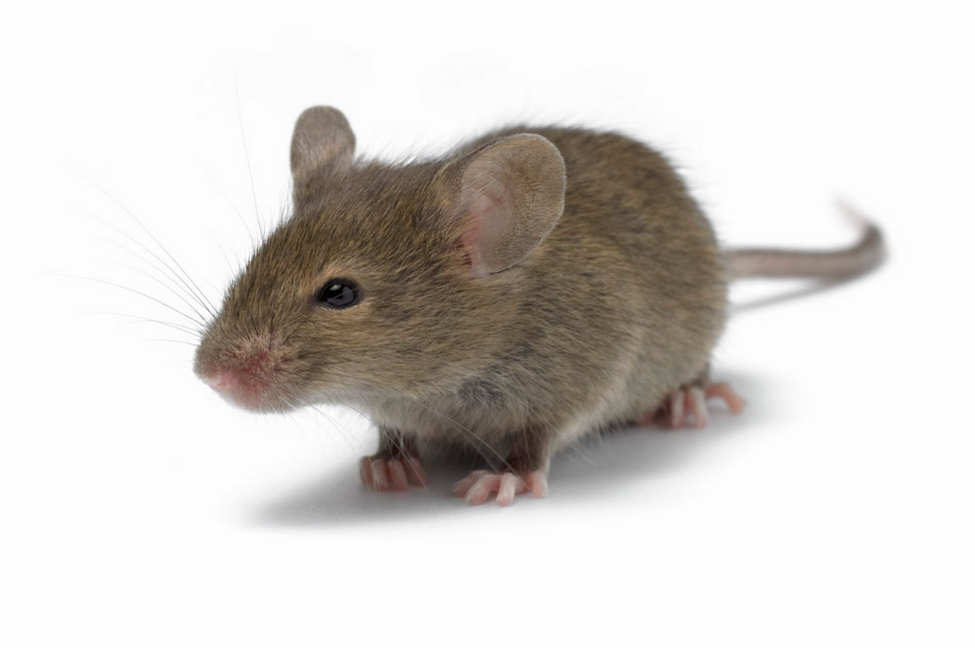
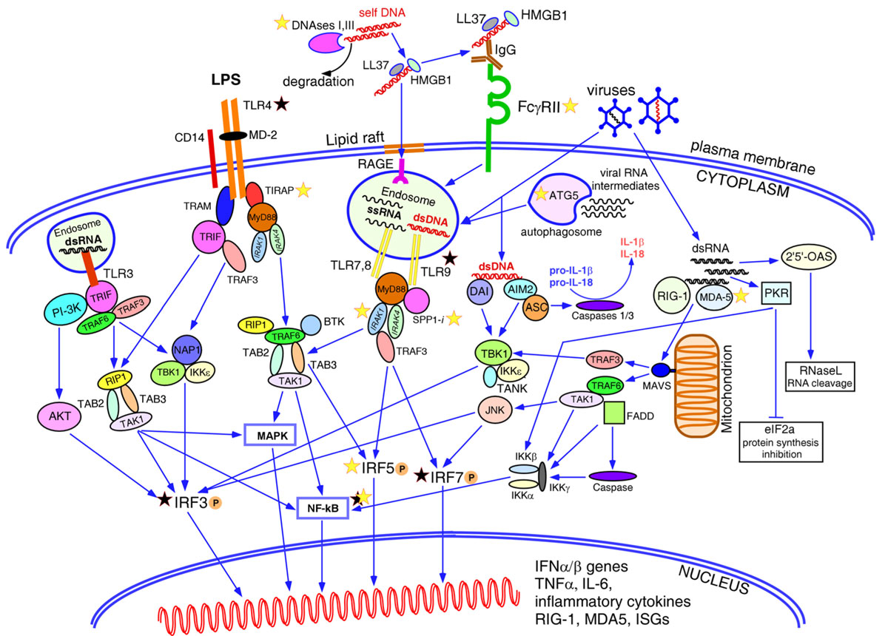
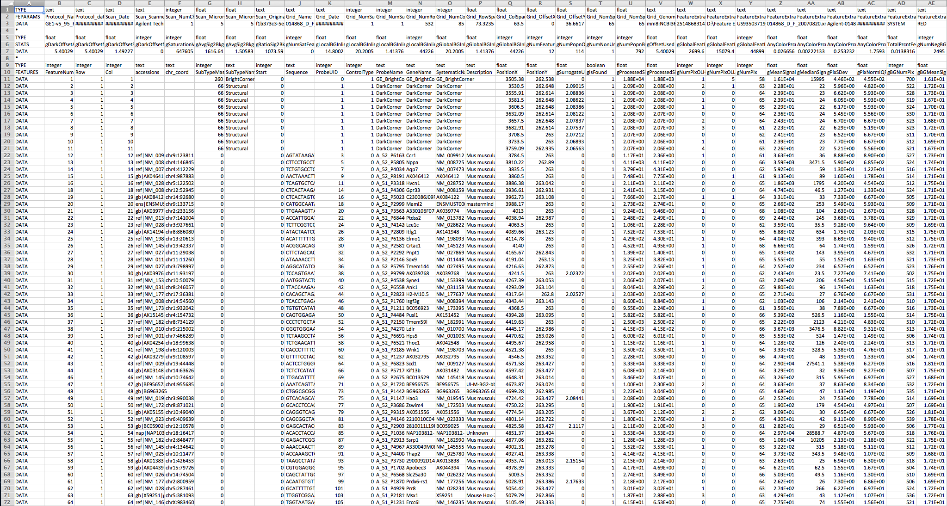
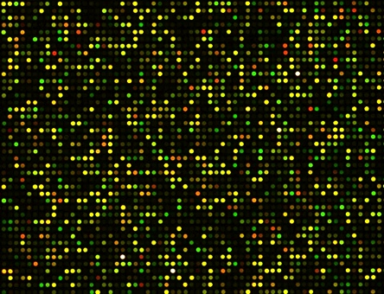
Data Levels in Biological Research

Slide 11
Derived data
Primary data

Slide 12
Experimental metadata
Interpreted data/
knowledge
Derived data
Primary data
Analytical metadata

Slide 13
Big Data in Biology

Slide 14
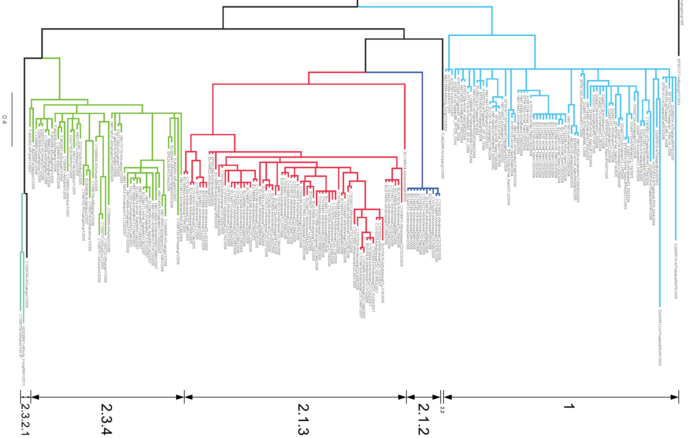
Variety

Slide 15
No Variety

Slide 16
Big Data
Volume + Variety = Value
Variety = Metadata

Slide 17
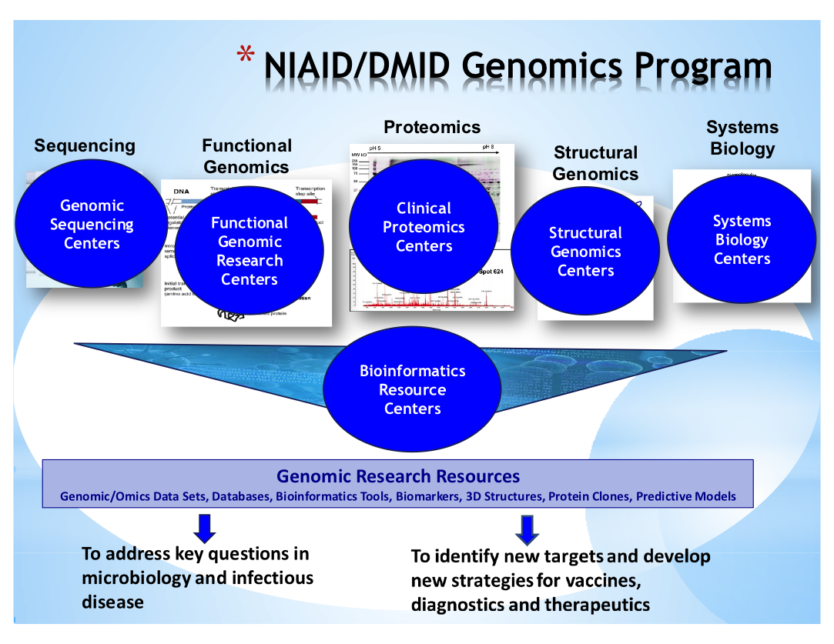
DMID Genomics
Courtesy of Alison Yao, DMID

Slide 18
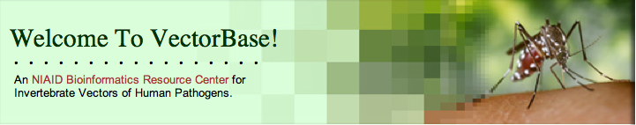





Bioinformatics Resource Centers (BRCs)
www.vectorbase.org
www.eupathdb.org
www.patricbrc.org
www.viprbrc.org
www.fludb.org
Notes:
In addition to supporting laboratory research projects, the U.S. National Institute of Allergy and Infectious Disease supports a series of research resources.
Three Genome Sequencing Centers at the University of Maryland, the J. Craig Venter Institute and the Broad Institute provide services for rapid and cost efficient production of high-quality, genome sequences and high-throughput genotyping of NIAID Category A-C priority pathogens, microorganisms responsible for emerging and re-emerging infectious diseases and their hosts, related organisms, clinical isolates, and invertebrate vectors of infectious diseases.
The sequences and associated metadata are made available and integrated with related pathogen through one of five different NIAID Bioinformatics Resource Centers focused on different subsets of human pathogens.
Two BRCs are focused on viral pathogens – the Virus Pathogen Resource (ViPR) and the Influenza Research Database.

Slide 19
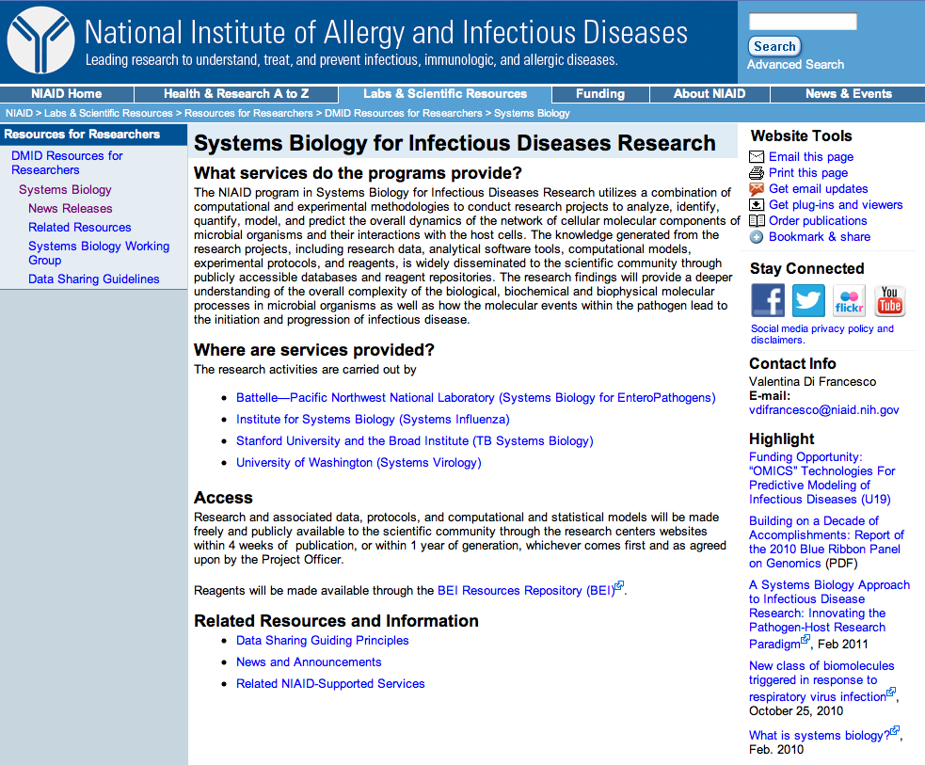
DMID Systems Biology Program

Slide 20
Systems Biology of Viral Infection
Systems Virology (Michael Katze group, Univ. Washington)
Influenza H1N1 and H5N1 and SARS Coronavirus
Statistical models, algorithms and software, raw and processed gene expression data, and proteomics data
Systems Influenza (Alan Aderem group, Institute for Systems Biology/Seattle Biomed)
Various influenza viruses
Microarray, mass spectrometry, and lipidomics data

Slide 21

Data Dissemination Working Group
Representatives from SysBio programs and relevant BRCs
Jeremy Zucker
Notes:
Off center

Slide 22
“Omics” Data Management
Project
Metadata
Pathogen
treatment
Data
processing
Data
interpretation
Assay 1
Biosamples
Cells/organisms
Treated
Samples
Primary
Data
Processed
Data Matrix
1.
Biosets
Assay 2
Biosamples
Cells/organisms
Treated
Samples
Primary
Data
Processed
Data Matrix
2.
Biosets

Slide 23
Strategy for Handling “Omics” Data
“Omics” data management (MIBBI)
Project metadata (1 template)
Title, PI, abstract, publications
Experiment metadata (~6 templates)
Biosamples, treatments, reagents, protocols, subjects
Primary results data
Raw expression values
Processed data
Data matrix of fold changes and p-values
Data processing metadata (1 template)
Normalization and summarization methods
Interpreted results (Host factor biosets)
Interesting gene, protein and metabolite lists
Data interpretation metadata (1 template)
Fold change and p-value cutoffs used
Visualize biosets in context of biological pathways and networks
Statistical analysis of pathway/sub-network overrepresentation

Slide 24
Data Submission Workflows
Free text metadata
GEO/PRIDE/PNNL/SRA/MetaboLights
Primary results
submission
Study metadata
pointer
submission
Experiment metadata
Analysis metadata
ViPR/IRD/PATRIC
Processed data matrix
pointer
Host factor bioset
Systems Biology sites

Slide 25
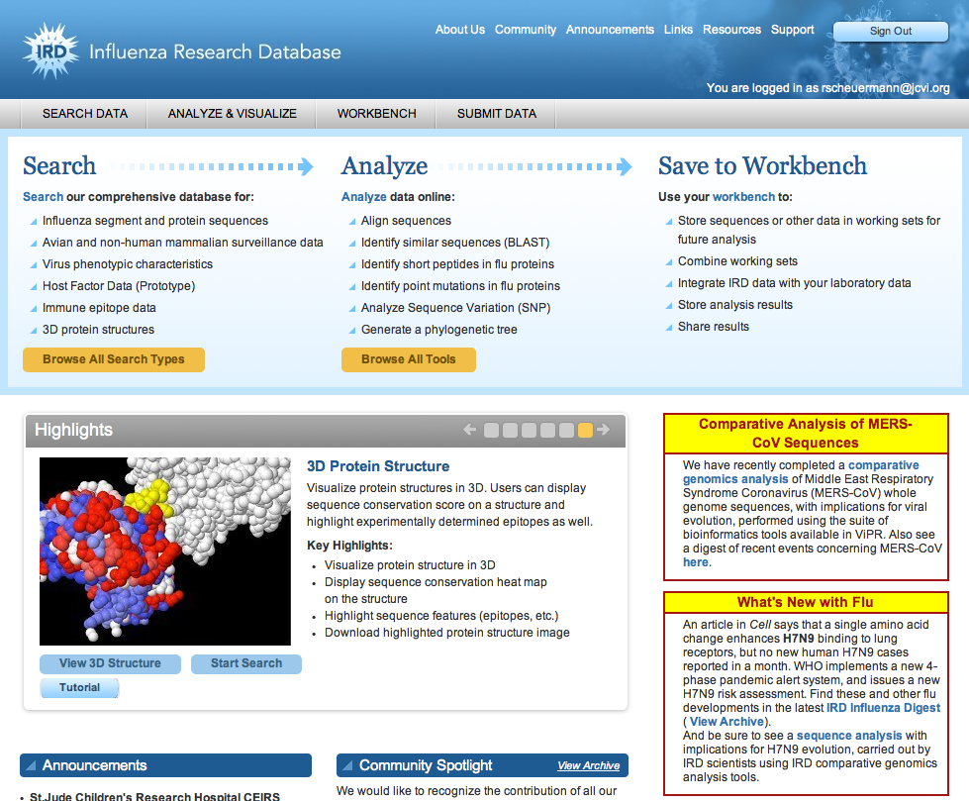
IRD Home Page
www.fludb.org

Slide 26
Live Demo

Slide 27
www.fludb.org

Slide 28
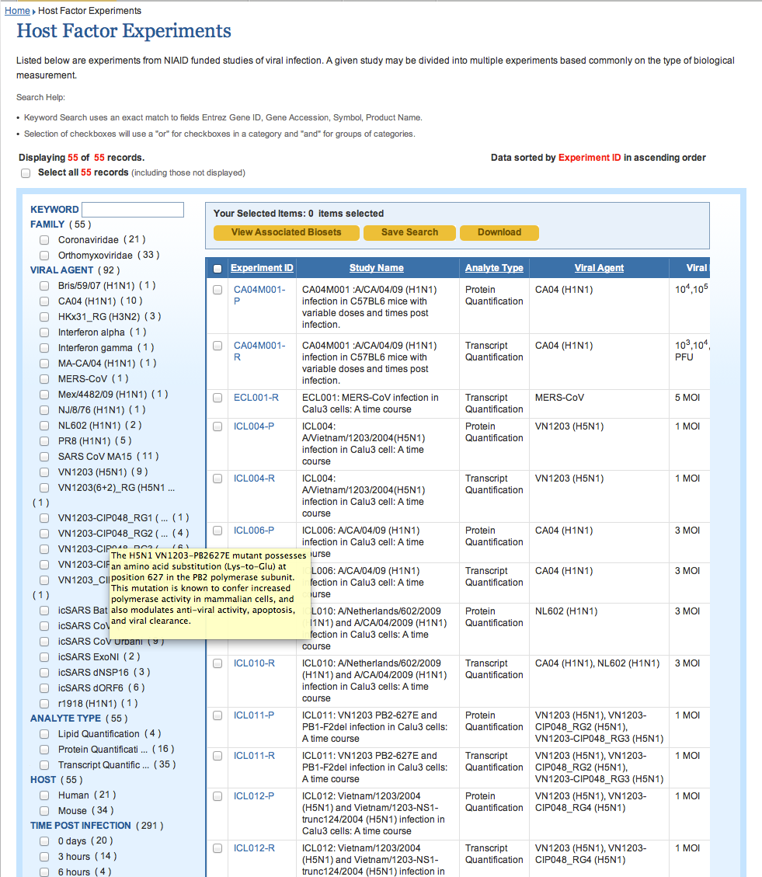
35 transcriptomic, 16 proteomic, 4 lipidomic experiments
2845 experiment samples
590 biosets
24 viral (flu, SARS, MERS) and 2 non-viral agents

Slide 29
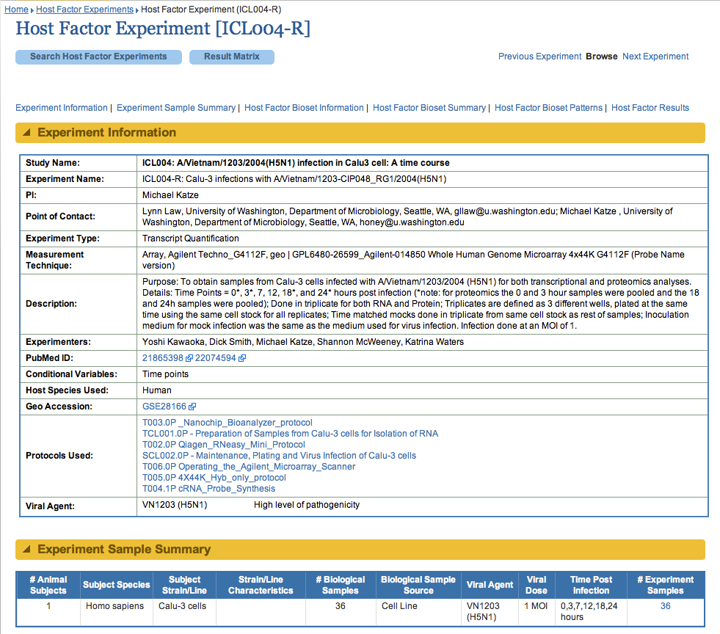

Slide 30
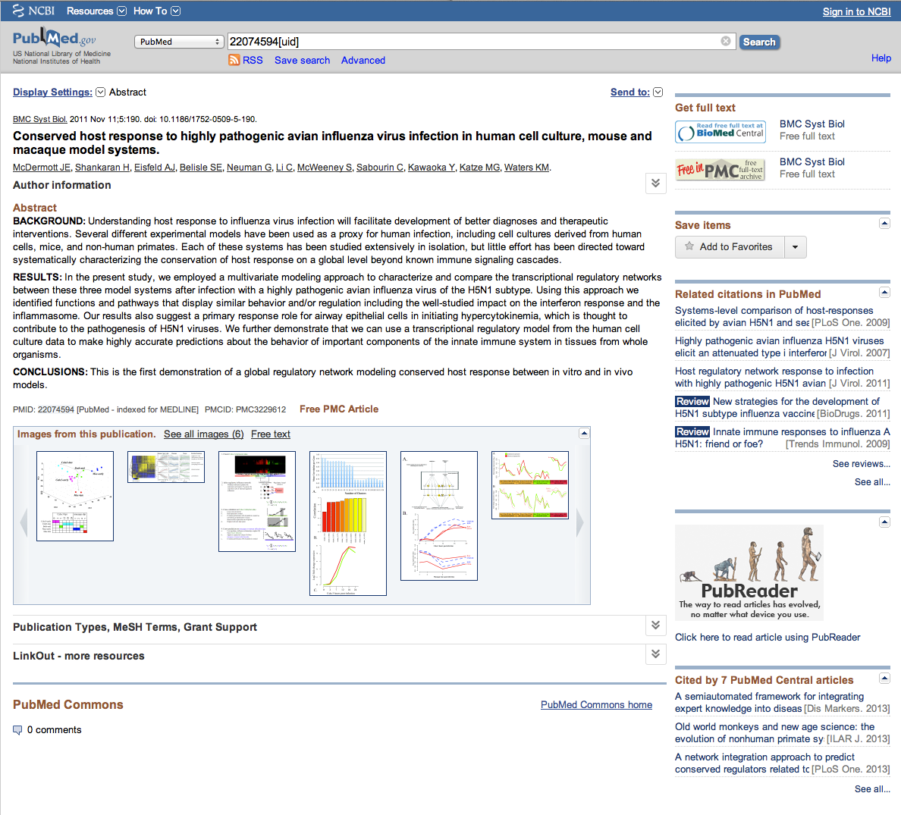

Slide 32
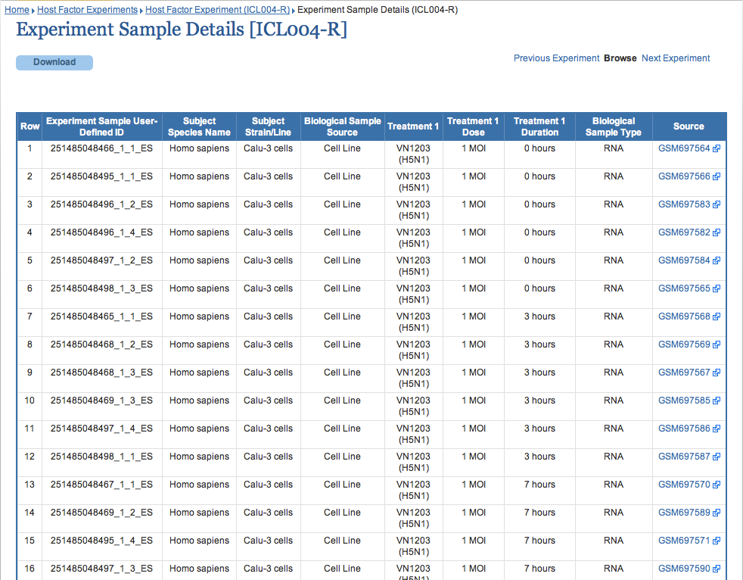

Slide 33
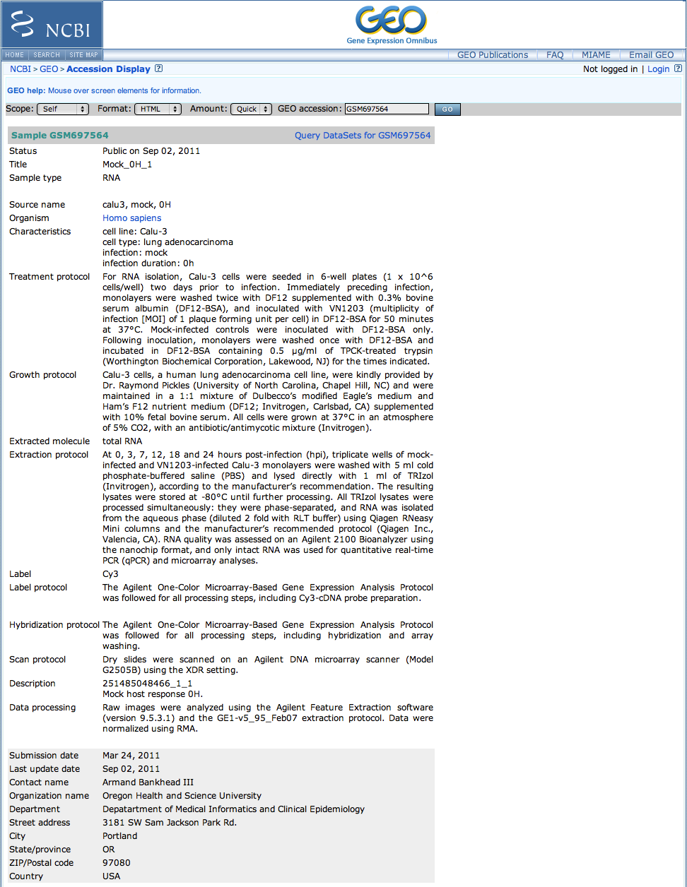

Slide 34
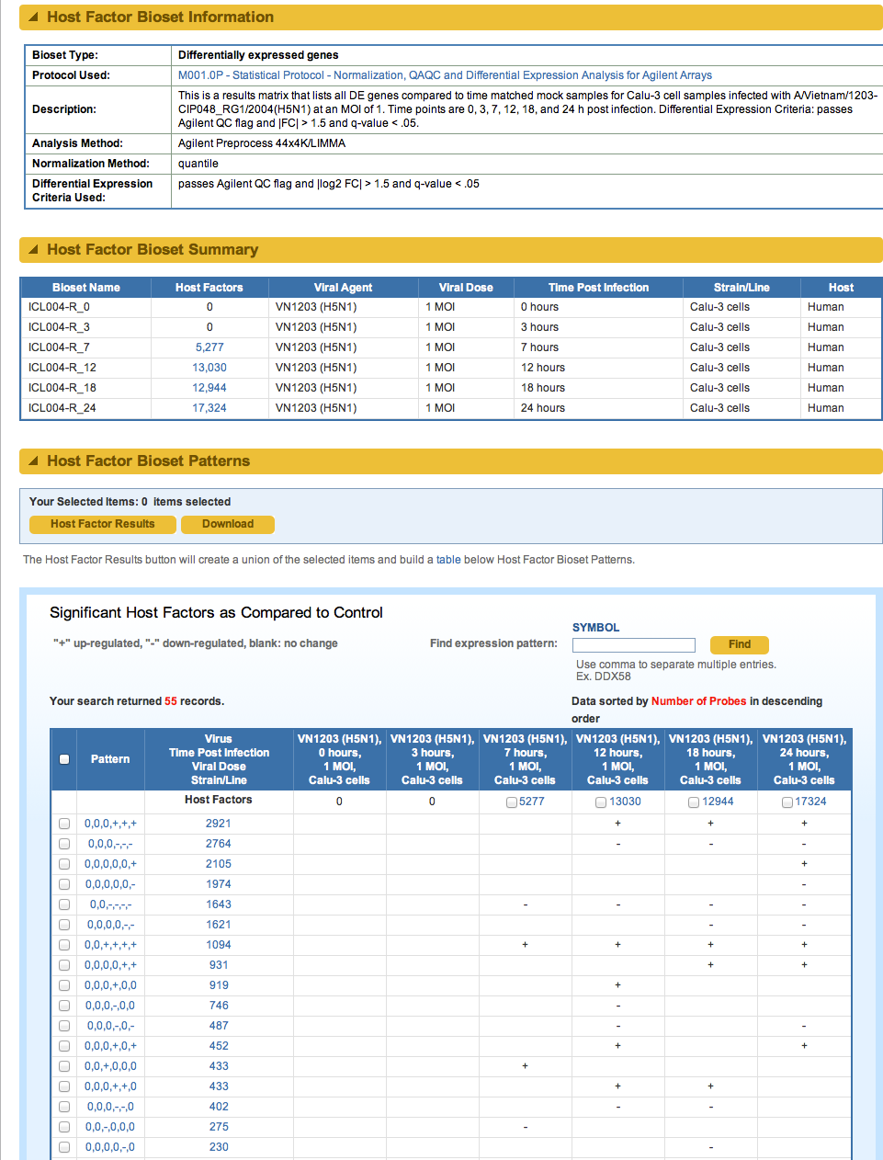

Slide 36
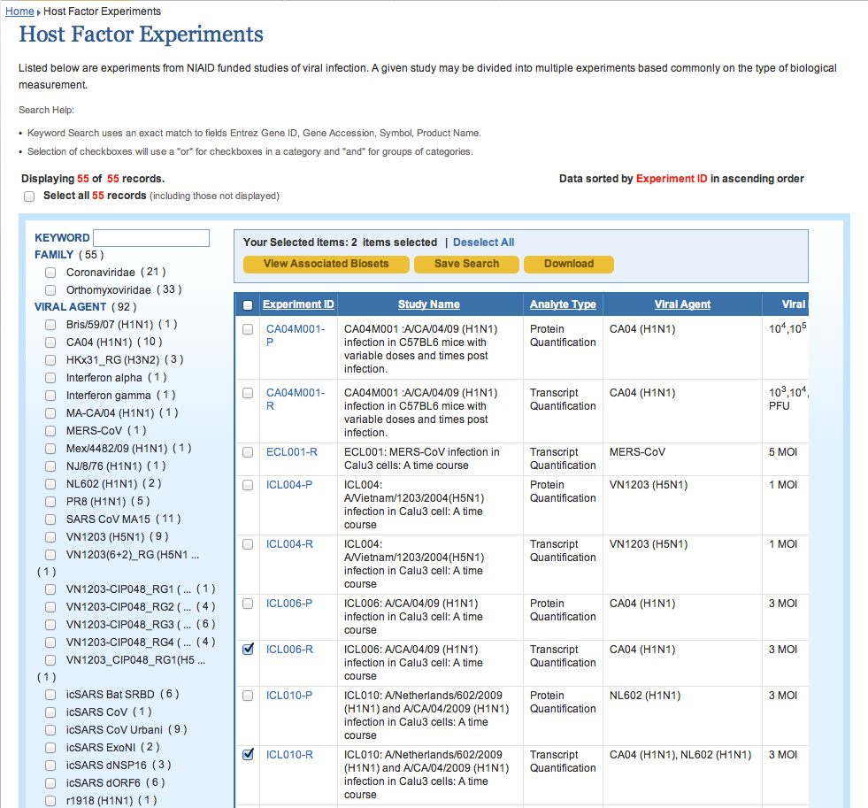

Slide 37
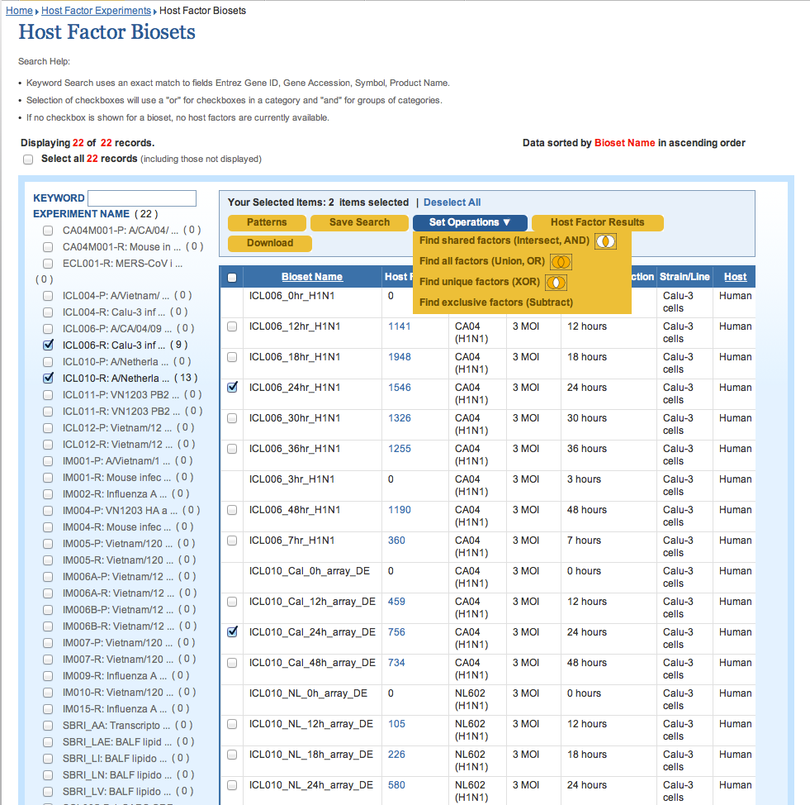

Slide 38
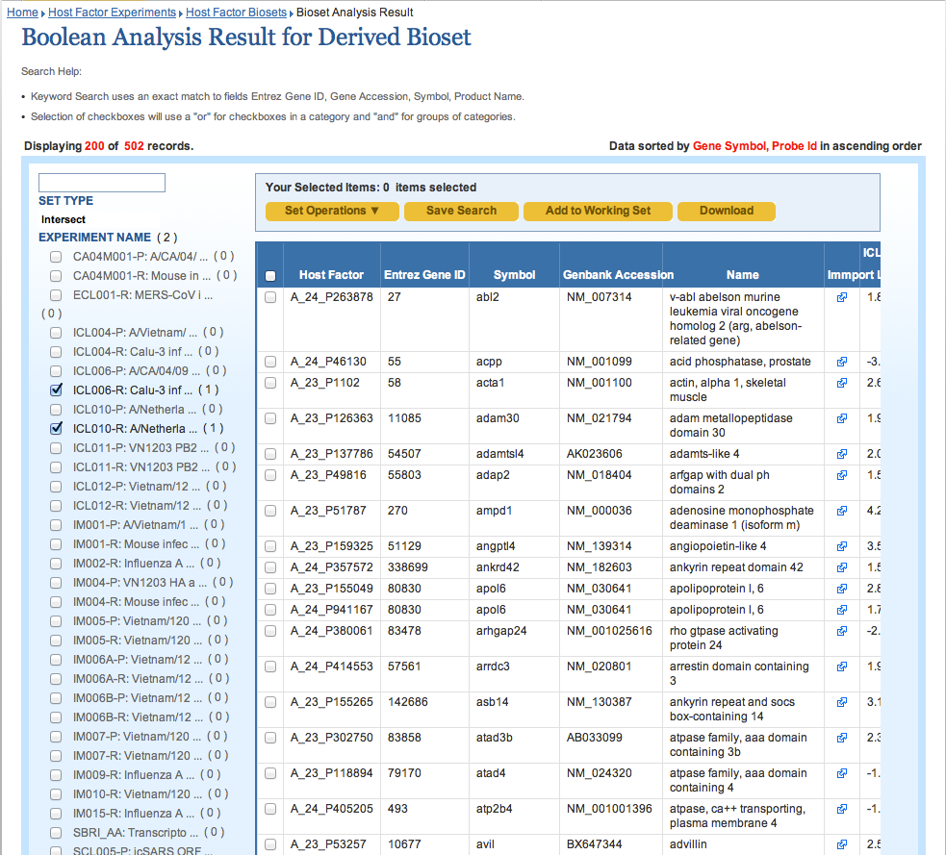

Slide 39
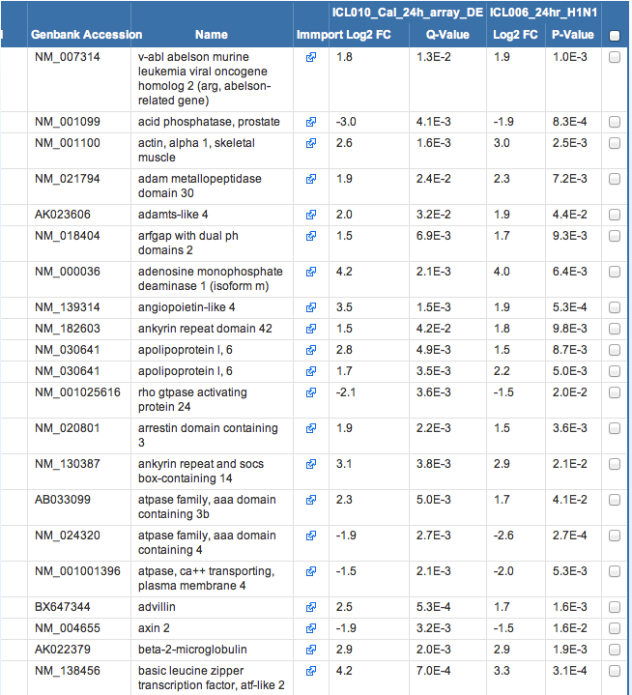

Slide 40
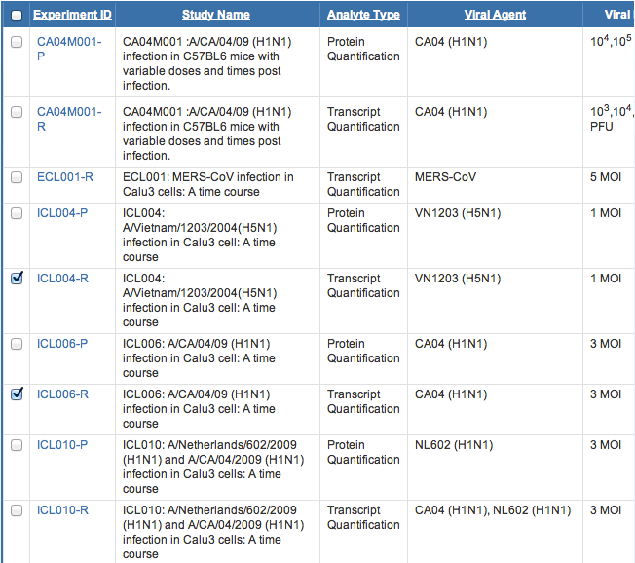

Slide 41
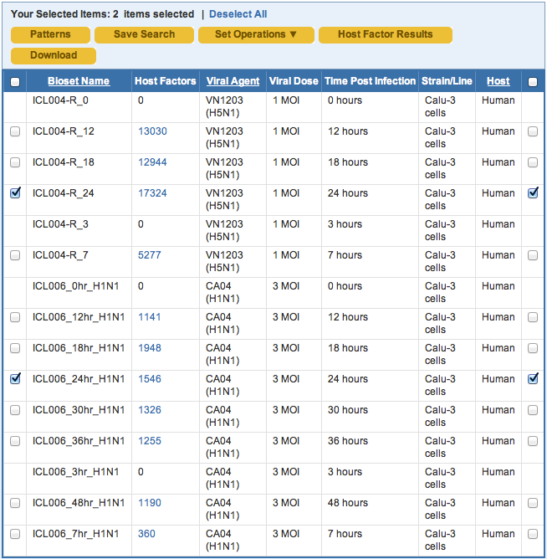

Slide 42
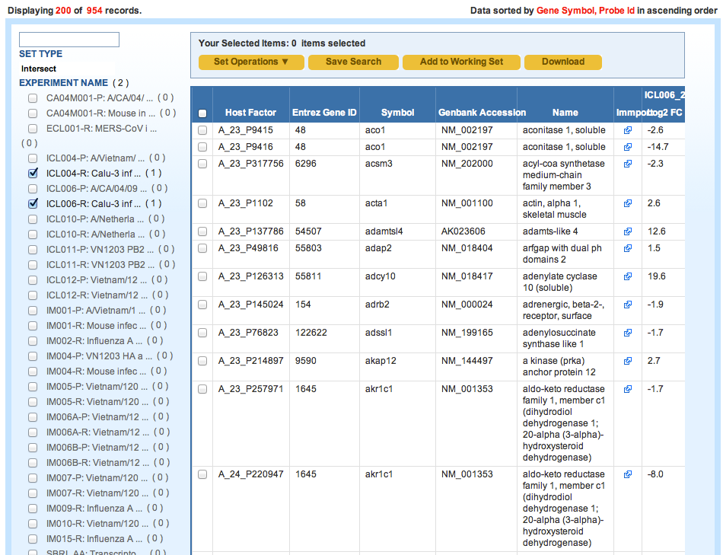

Slide 43
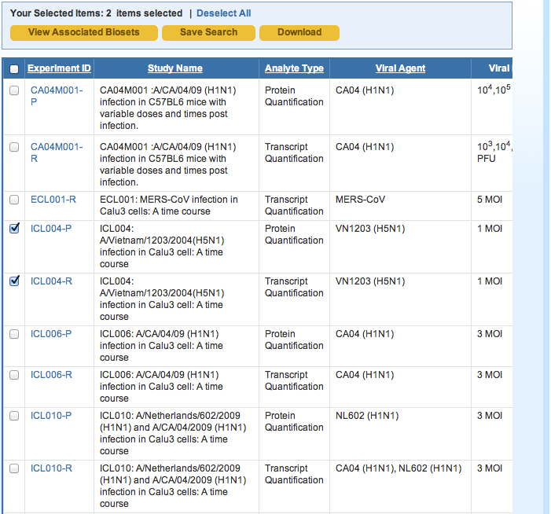

Slide 44
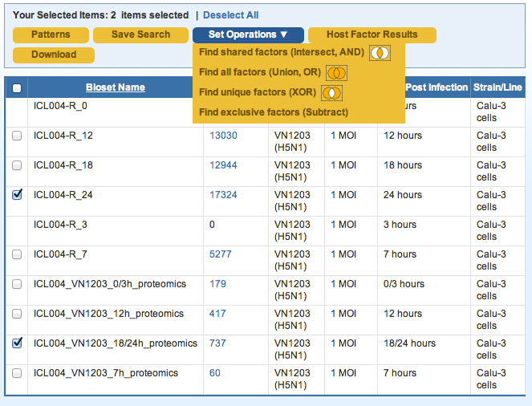

Slide 45
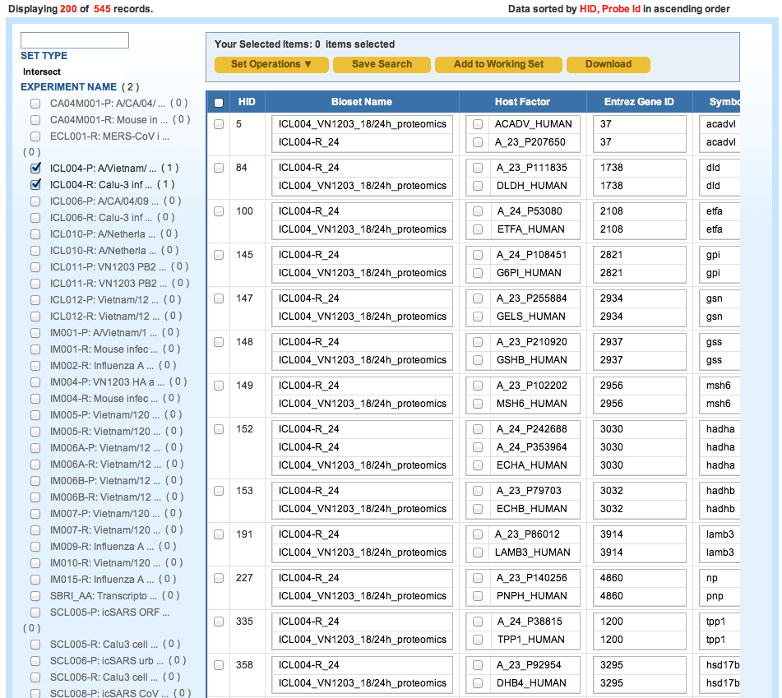

Slide 47
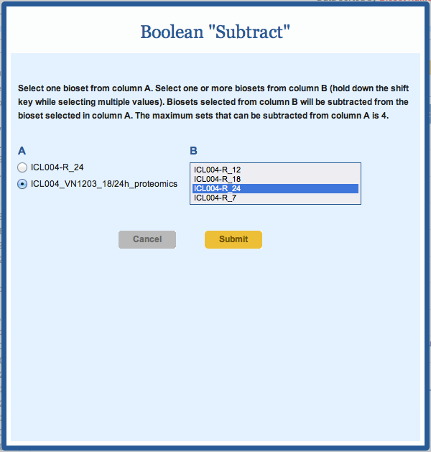

Slide 48
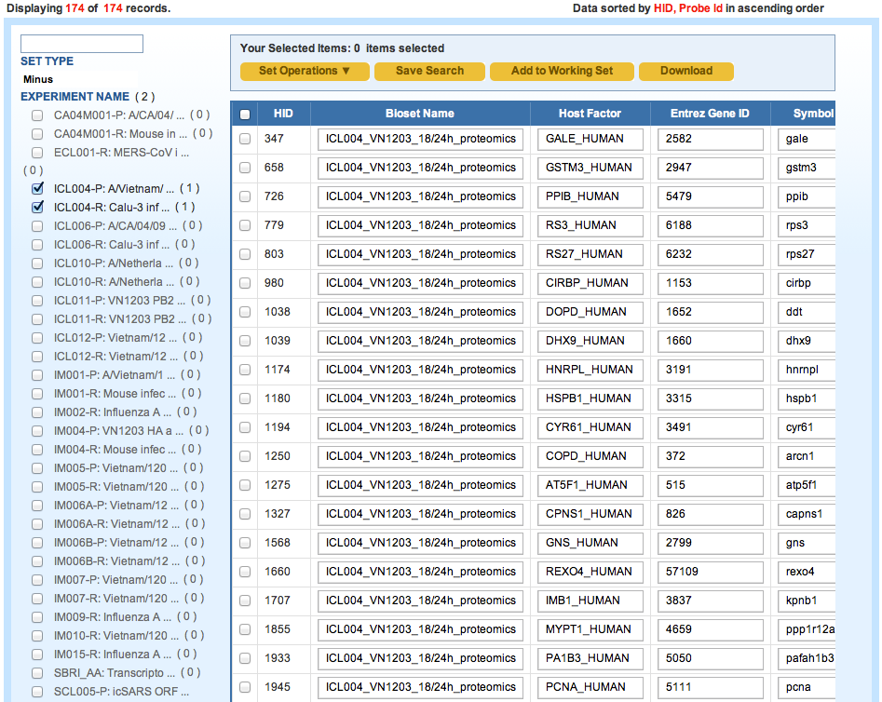

Slide 49
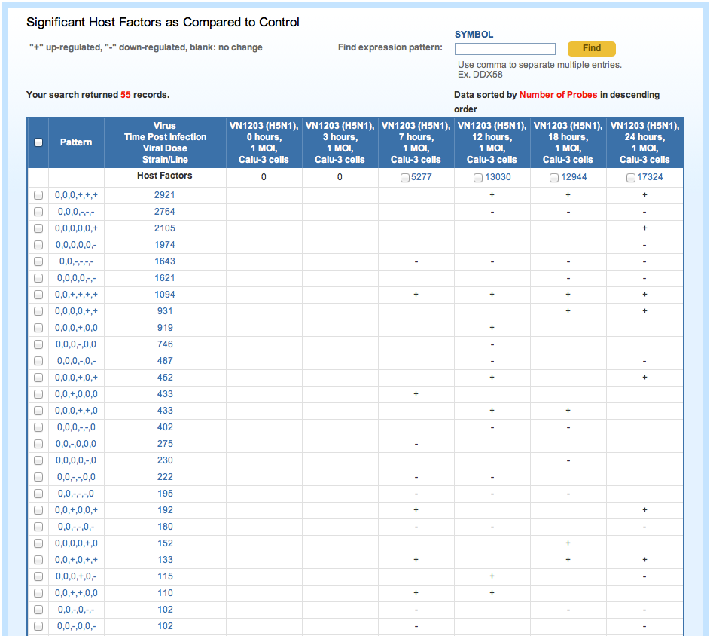

Slide 50
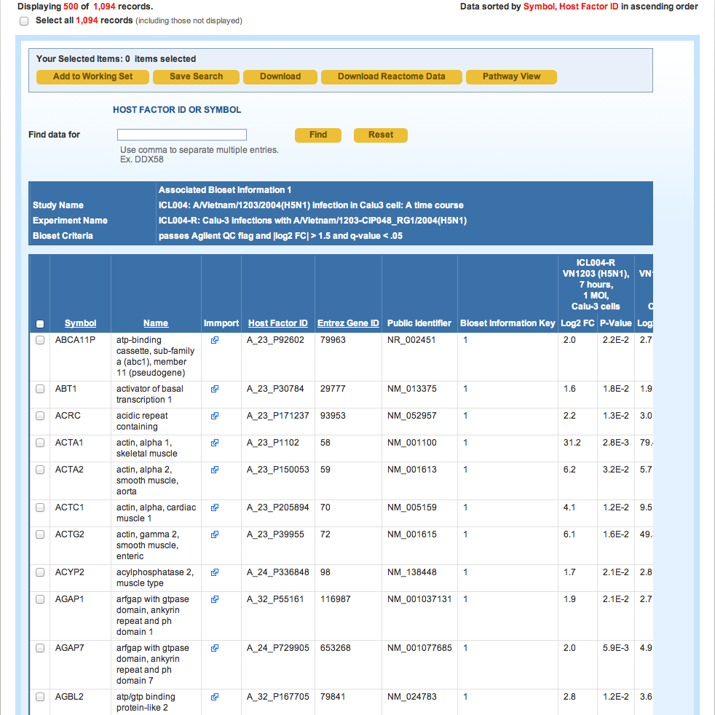

Slide 51
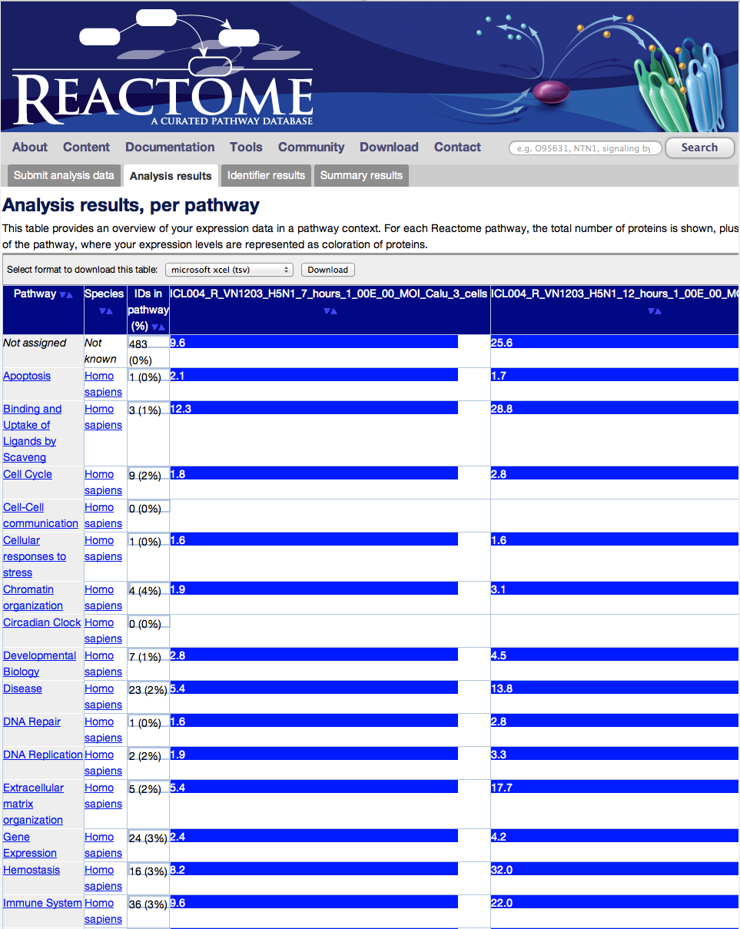
Reactome section

Slide 52
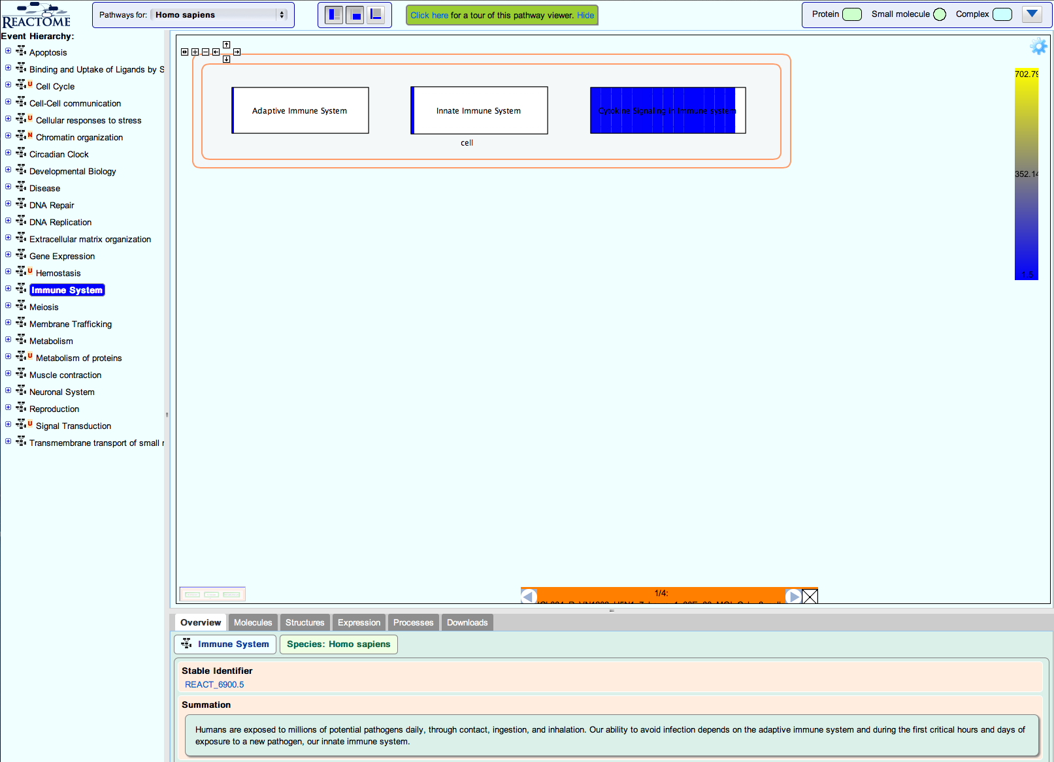

Slide 53
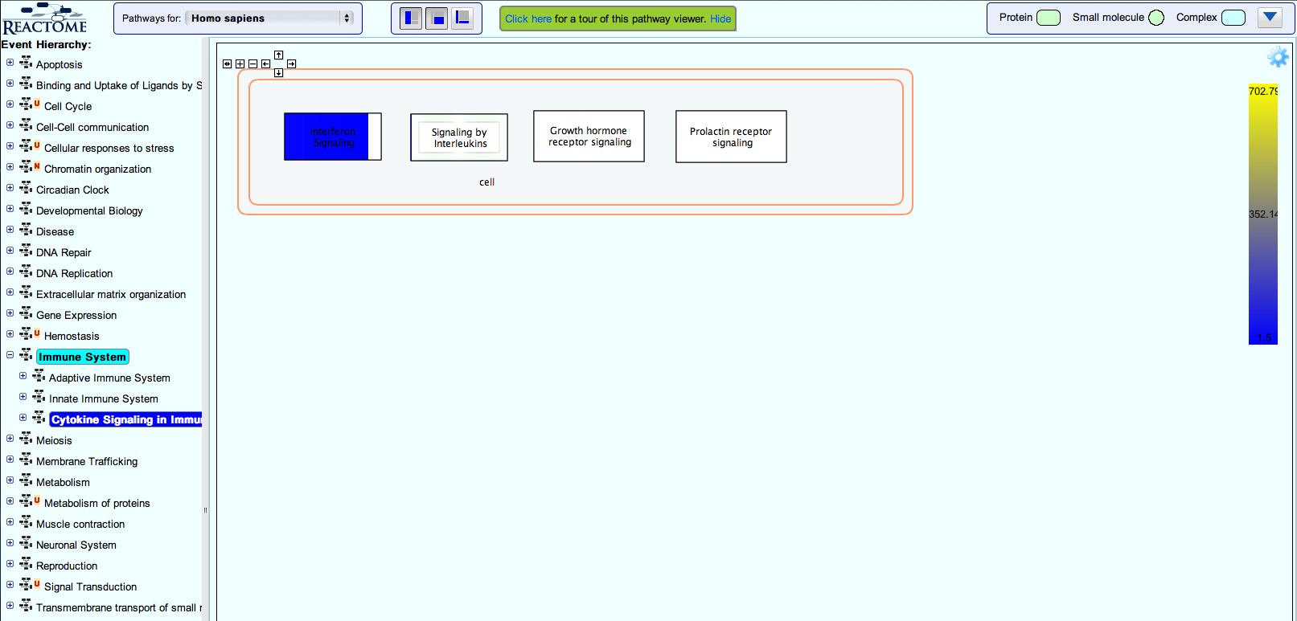

Slide 54
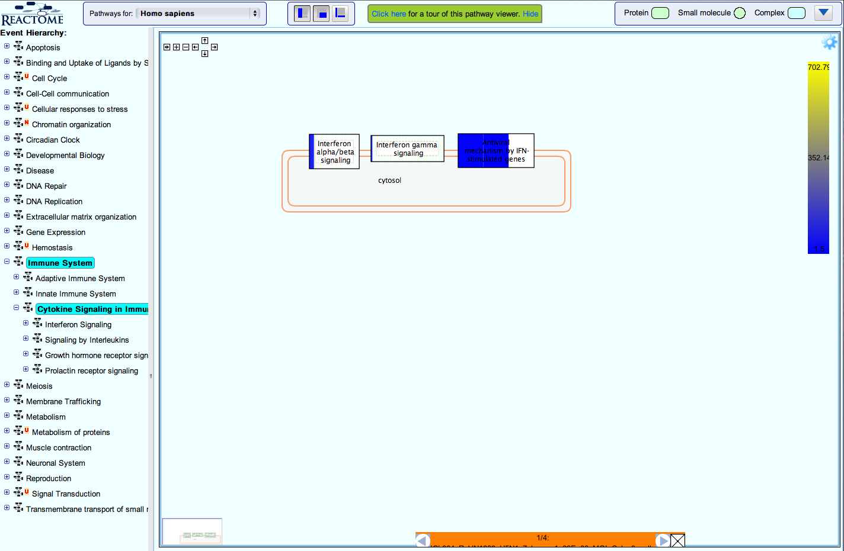

Slide 55
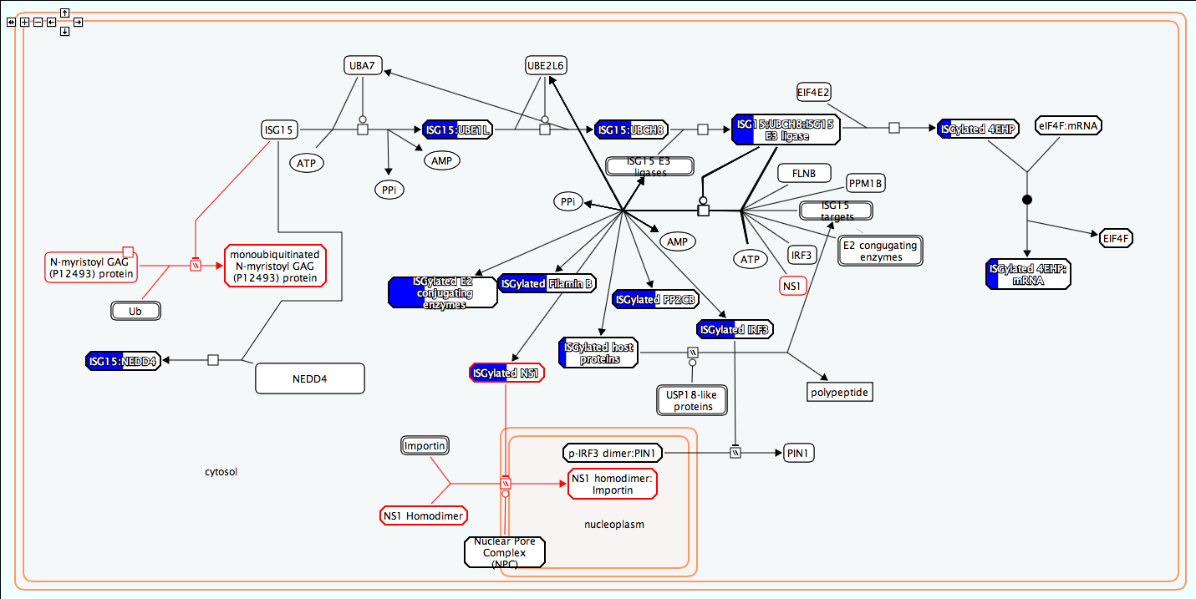

Slide 56
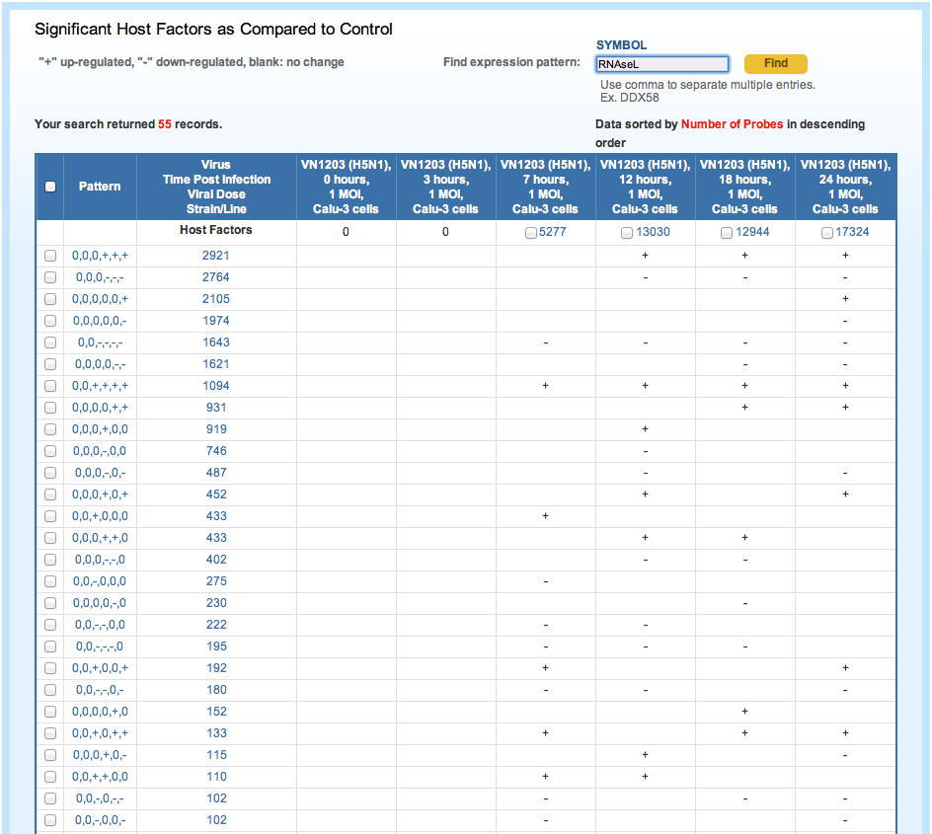

Slide 57
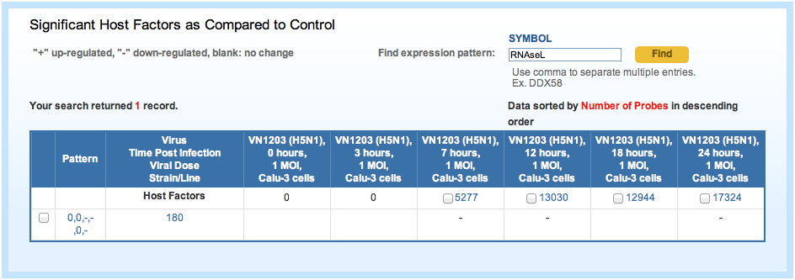

Slide 59
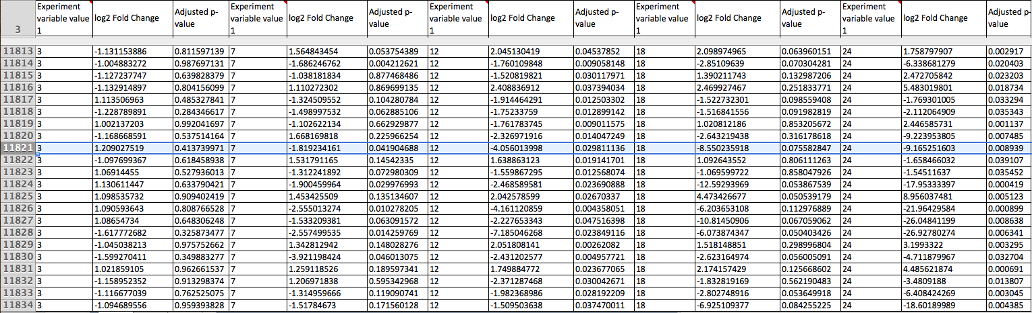

Slide 60
Summary of “Omics” Data Support in IRD/ViPR
Structured metadata about study, experiments, analysis methods
Series of derived biosets
Boolean analysis of biosets from different experiments
Biosets based on expression patterns
Search for expression patterns of specific genes
Access to complete data matrix
Data linkout to pathway knowledgebase

Slide 61
Big Data to Knowledge
Volume + Variety = Value
Variety = Metadata
Data + Metadata + Interpretation = Knowledge

Slide 62
Acknowledgement
Lynn Law, Richard Green - U. Washington
Peter Askovich - Seattle Biomed
Brian Aevermann, Brett Pickett, Doug Greer, Yun Zhang - JCVI
Entire Systems Biology Data Dissemination Working Group, especially Jeremy Zucker
NIAID (Alison Yao and Valentina DiFrancesco)
Entire ViPR/IRD development team at JCVI and Northrop Grumman
NIAID/NIH - N01AI40041

